Slide 1



AUDIO RECORDER AND AUDIO PLAYER USING PYTHON
PROJECT MEMBERS:
P JAYASWATI 23ITR069
M JEYASANJAY 23ITR074
M MYTHILI 23ITR106ARI D (19ITR028)

Slide 2

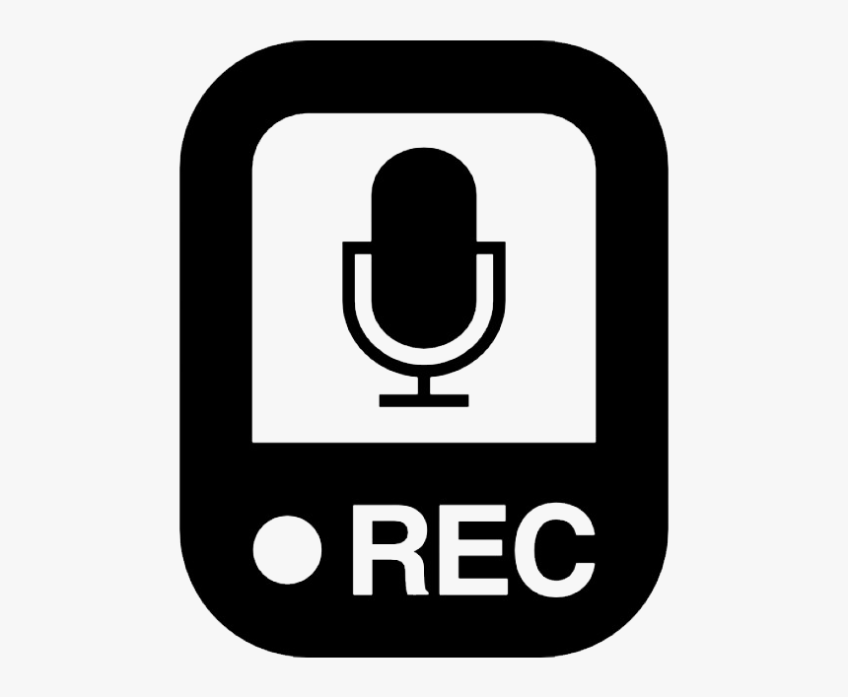
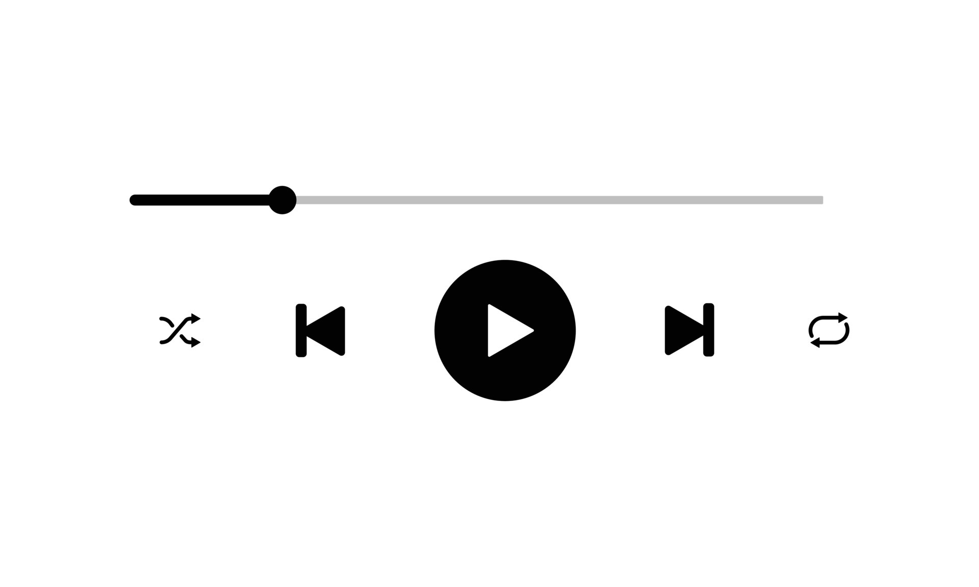
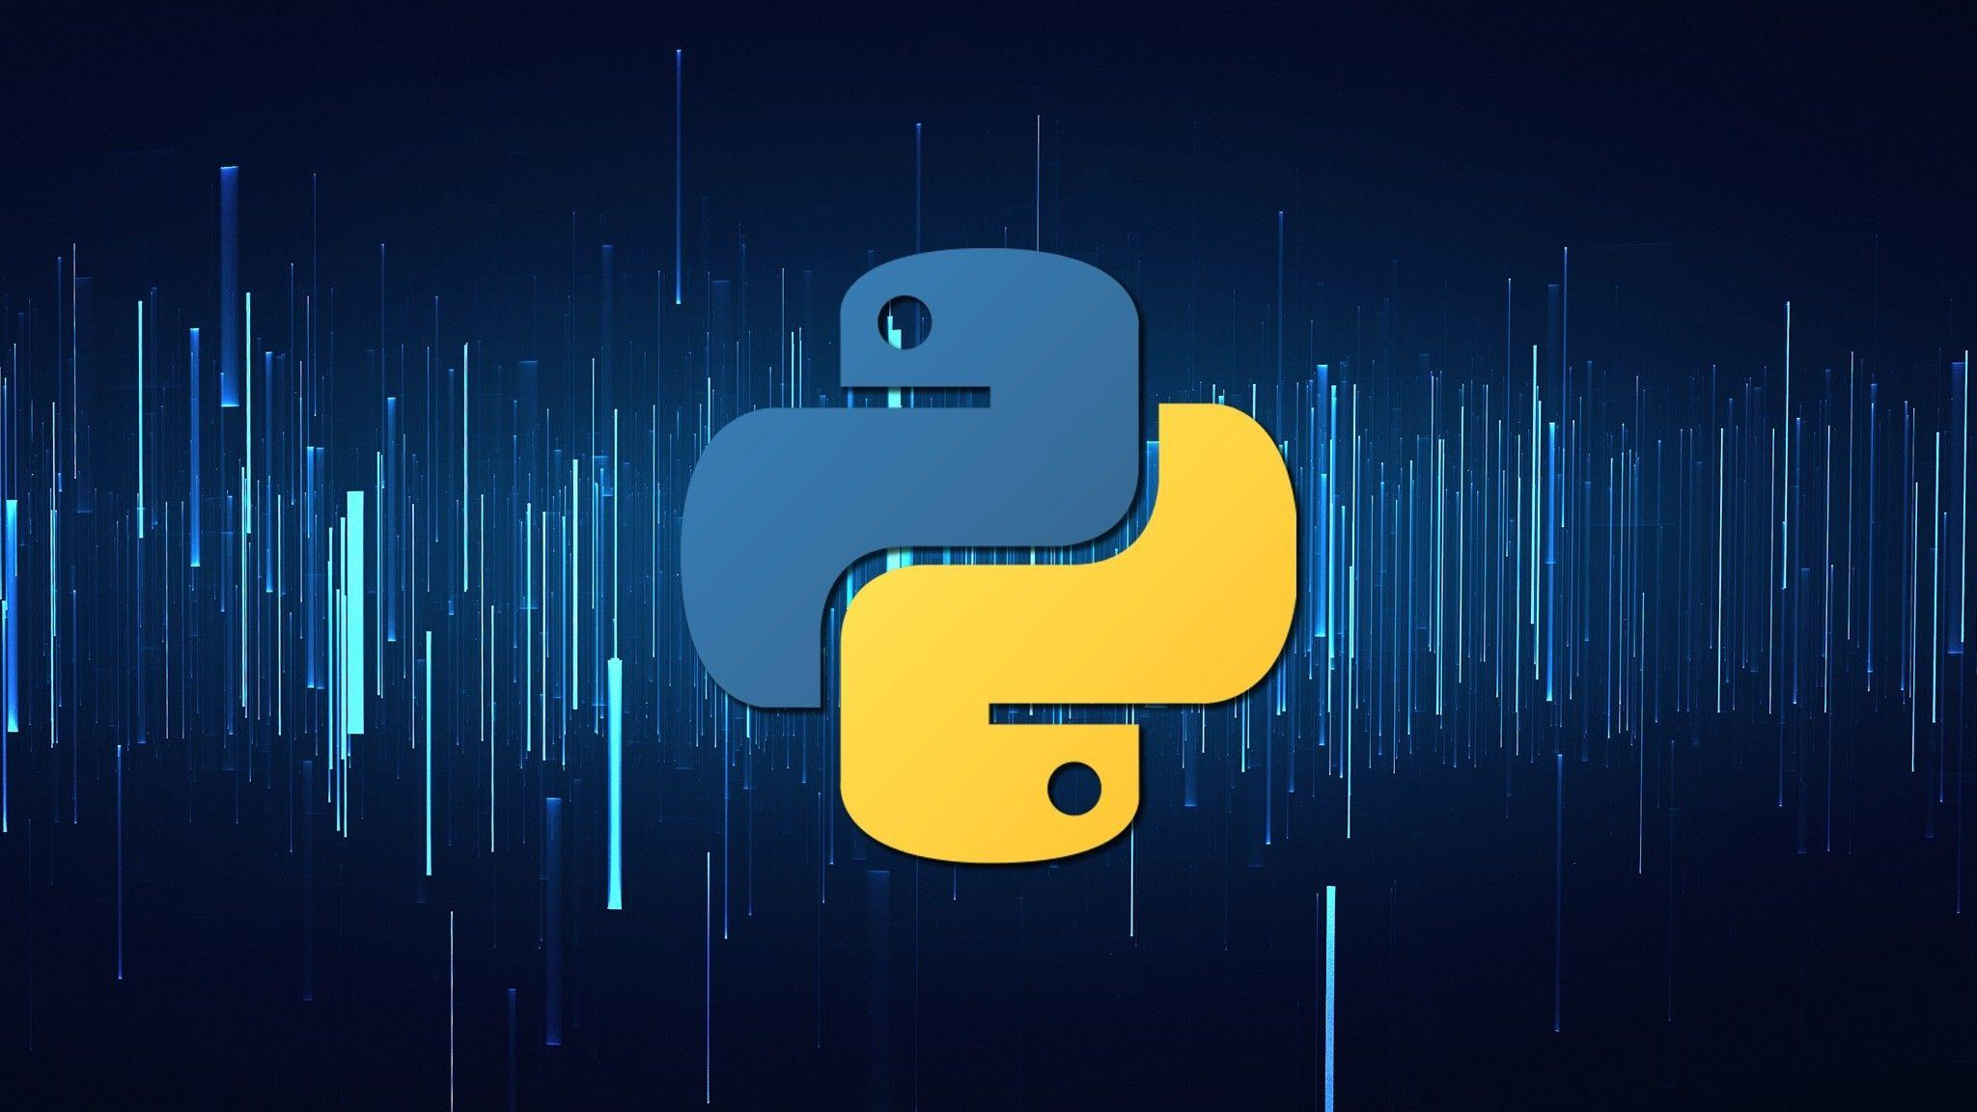
To develop a Python application that can both record and playback any audio.
This application should provide users with a simple interface to start recording audio through a microphone and save it as an audio file.
Users should also be able to play back the recorded audio file through the same application.

Slide 3
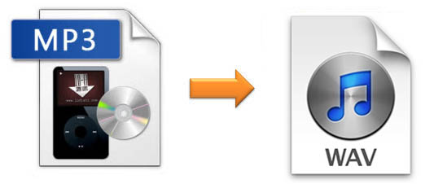
Objectives
To capture audio from the microphone and save it in a commonly used audio format, such as WAV or MP3.
To develop a playback feature that allows users to listen to the recorded audio file through the application's interface.
3

Slide 4
Software Tools used
Python: The primary programming language for developing the application.
Libraries:
pyaudio: For capturing audio input from the microphone and managing real-time audio streaming.
wave: For saving recorded audio in WAV format (if using WAV).
pydub: For handling audio file formats and conversion (if using MP3 or other formats).
Tkinter : For creating a graphical user interface (GUI) to interact with the audio recorder and player.
Sound Device: It provides a efficient way to record & playback
4

Slide 5
Implementation Details
Set Up the Environment
Create a GUI with Tkinter
Implement Audio Recording
Implement Audio Playback
Run the Application
5

Slide 6
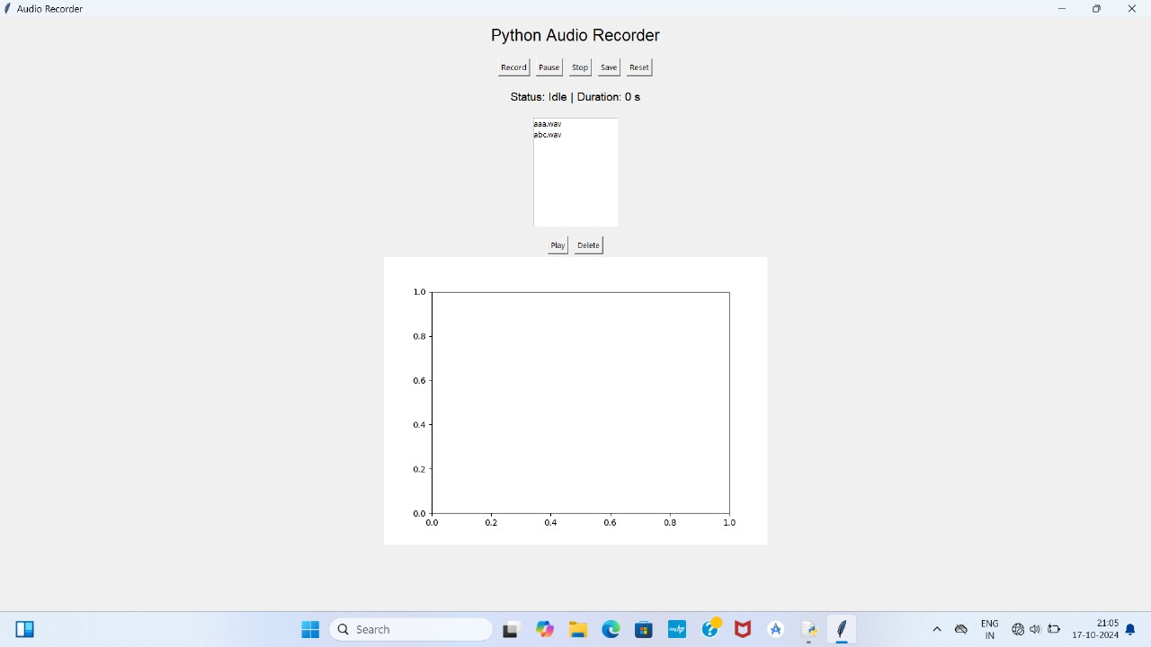
MODULE 1
HOME PAGE

Slide 7
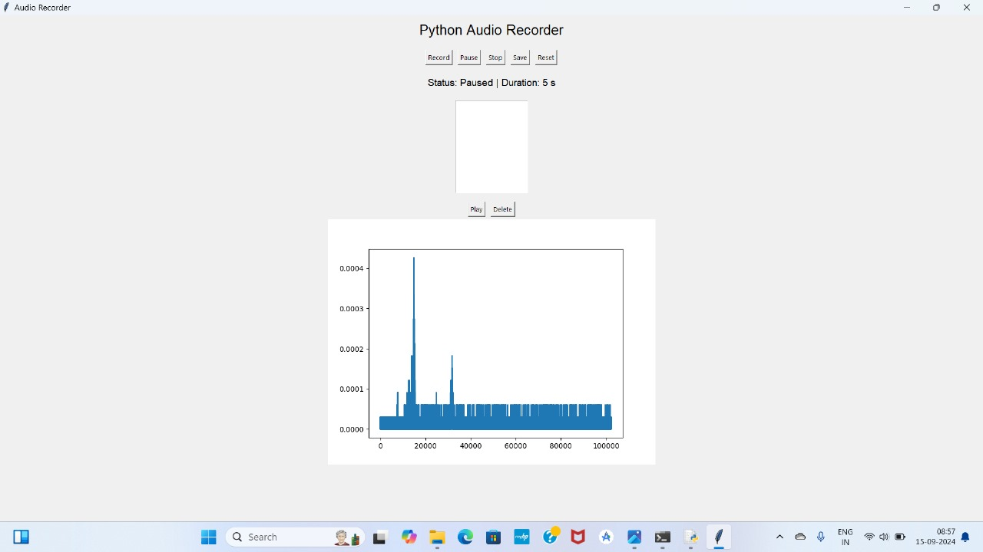
MODULE 2
AUDIO RECORDER

Slide 8
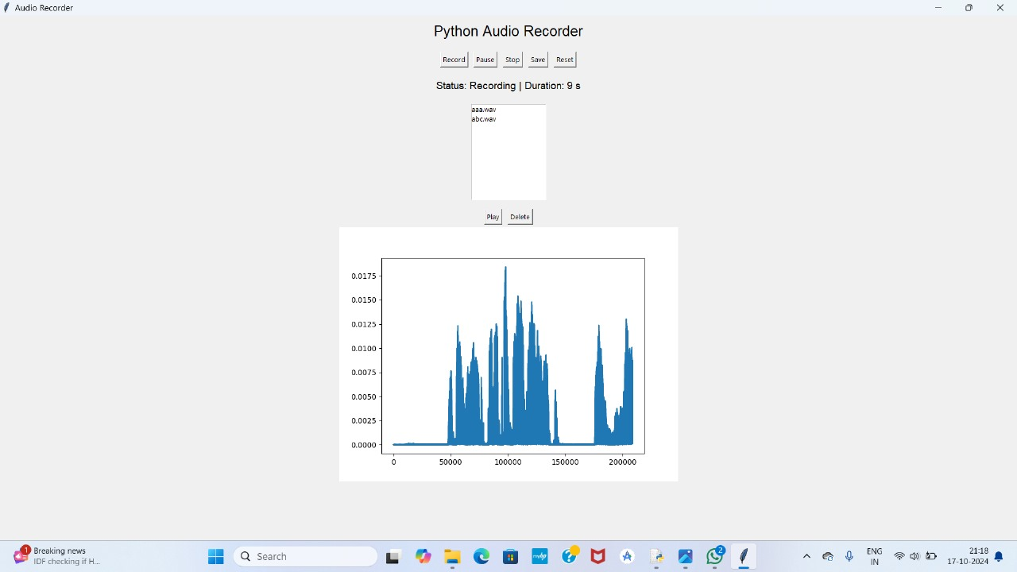
MODULE 3
AUDIO PLAYER

Slide 9
REFERENCE
https://www.w3schools.com/python/python_reference.asp
https://realpython.com/playing-and-recording-sound-python/
https://www.tutorialspoint.com/python/index.htm
https://www.geeksforgeeks.org/python-programming-language-tutorial/
The Recording Engineer's Handbook" by Bobby Owsinski
Mixing Secrets for the Small Studio" by Mike Senior
The Art of Music Production" by Richard James Burgess
Sound on Sound: A monthly magazine covering all aspects of recording, mixing, and music technology.

Slide 10
Thank you!

